Slide 1

Employee Data Analysis using Excel
STUDENT NAME: S.Ramya
REGISTER NO:312208566
DEPARTMENT:B.COM[GENERAL]
COLLEGE : Chellammal womens college Guindy chennai
1
Notes:
1

Slide 2

PROJECT TITLE
Employee Performance Analysis using Excel
2

Slide 3



AGENDA
Problem Statement
Project Overview
End Users
Our Solution and Proposition
Dataset Description
Modelling Approach
Results and Discussion
Conclusion
3/21/2024 Annual Review
3

Slide 4

PROBLEM STATEMENT
The tool should track performance ratings ,calculate individual scores,and provide insights into departmental and organizational trends.
By leveraging data analytics,I aim to enhance employee growth,optimize talent allocation,and boost organizational success.
4

Slide 5

PROJECT OVERVIEW
.Employee performance analysis using excel project to develop an excel dashboard to analysis employee performance, track data , and provide insights for informed decisions on talent development and growth.
5

Slide 6

WHO ARE THE END USERS?
Employee
Employers
Organisation
Different industries
IT sectors
Senior leaderships
HR Analysts
6

Slide 7

OUR SOLUTION AND ITS VALUE PROPOSITION
Filtering-missing
chats - visualization , reports
Pivot table-summary
Conditional techniques identify
7

Slide 8
Dataset Description
Employee dataset- kaggle
26 features
9features
Employee id
Name-text
Rating-numeric
Performance-text
Gender[ Female,Male ]
Business unit-text
Business type-text

Slide 9

THE "WOW" IN OUR SOLUTION
Border
Alignment
Heading colour
3/21/2024 Annual Review
9

Slide 10
MODELLING
Data Collection : Employee Data set collected from Kaggle
Data cleaning : Remove extra Blank Spaces in the data
Techniques : Used Filter for removing blank columns & IF Formula for analysing the Employee Performance
Results : Creating Bar Diagram for checking the employee performance
Pivot Table : Separate the gender wise Employee Performance into 4 category as Very high, High, Medium, Low
Chart Graphs : It shows clear performance of employees
10

Slide 11
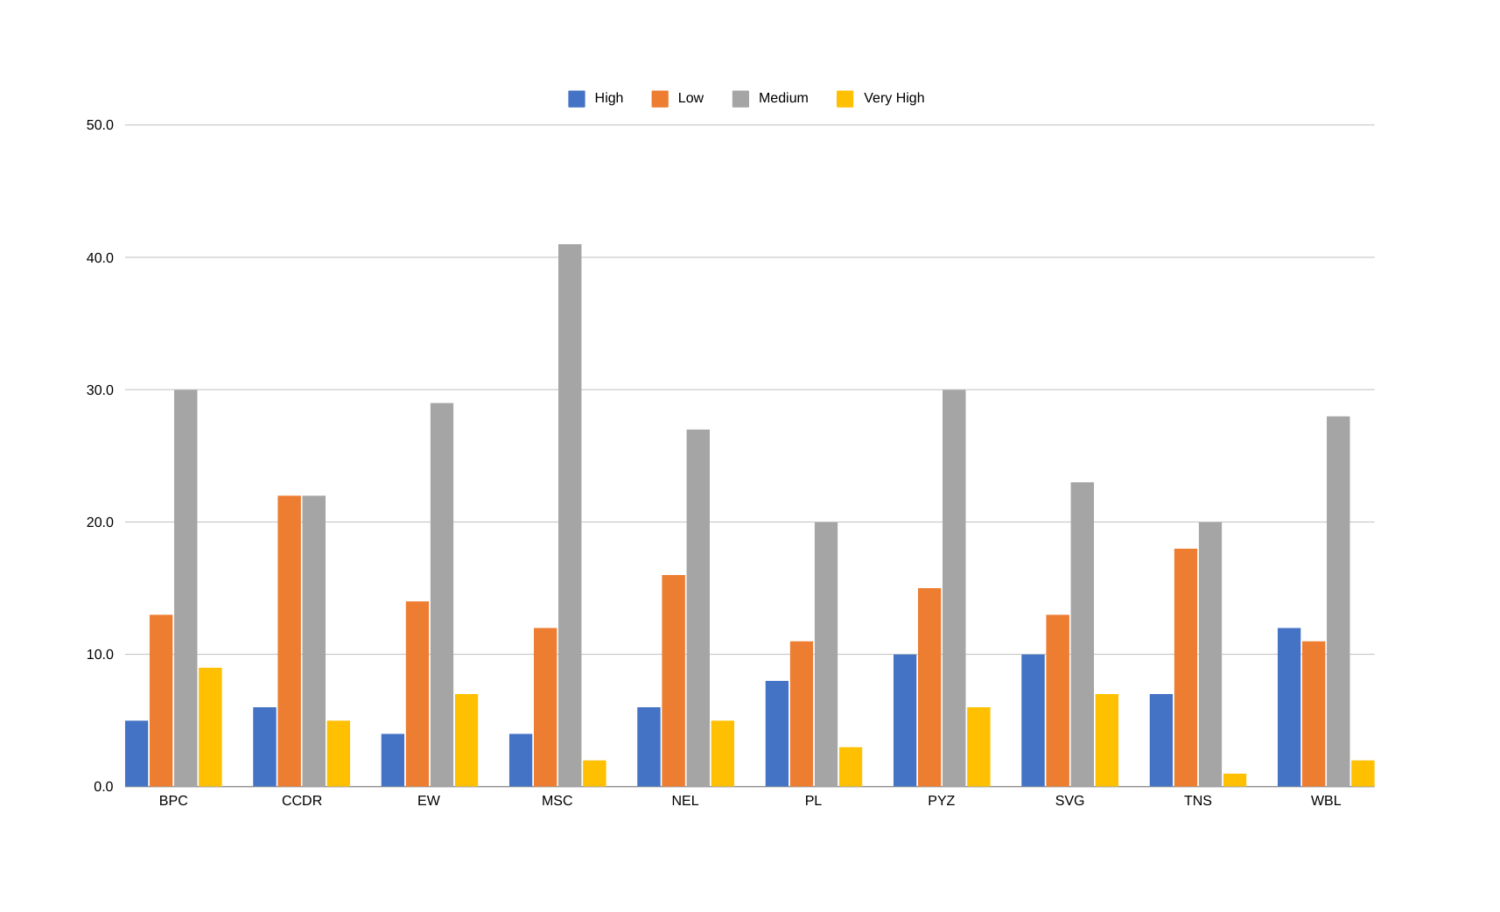
RESULTS
11

Slide 12
Conclusion
This having a powerful tools that helps to me understand . This project created an excel
dashboard that does just that , it:
Tracks your progress ,
Highlights your strengths and weakneses ,
Helps your supervisor make informed decisions about your growth.
This project can help me like;
Improve skills ,
Get better job opportunities,
Achieve career goals.

